Slide 1
Efficient Facial Image Restoration Using LoRA-Based Finetune
Sam Kang, k.kaiyuan@wustl.edu, CIG, WashU
Mentored by Prof. Ulugbek S. Kamilov and Yuyang Hu

Slide 2
Project Overview
Restoration by Generation with Constrained Priors (Gen2Res)
  Album Size influence on Finetune
LoRA-Based Finetune Extension
  Attention Layer LoRA
    LoRA scale effects
  Residual block and timestep embedding LoRA
  Efficiency comparision

Slide 3
Gen2Res Framework
Preprocessing
Face alignment
Training
Train base UNet diffusion model for general restoration
Finetuning
Full model retraining on base model using personal/generative images
Constrain features and increase accuracy
Restoration
Denoise with base/fine-tuned model to restore clear image

Slide 4
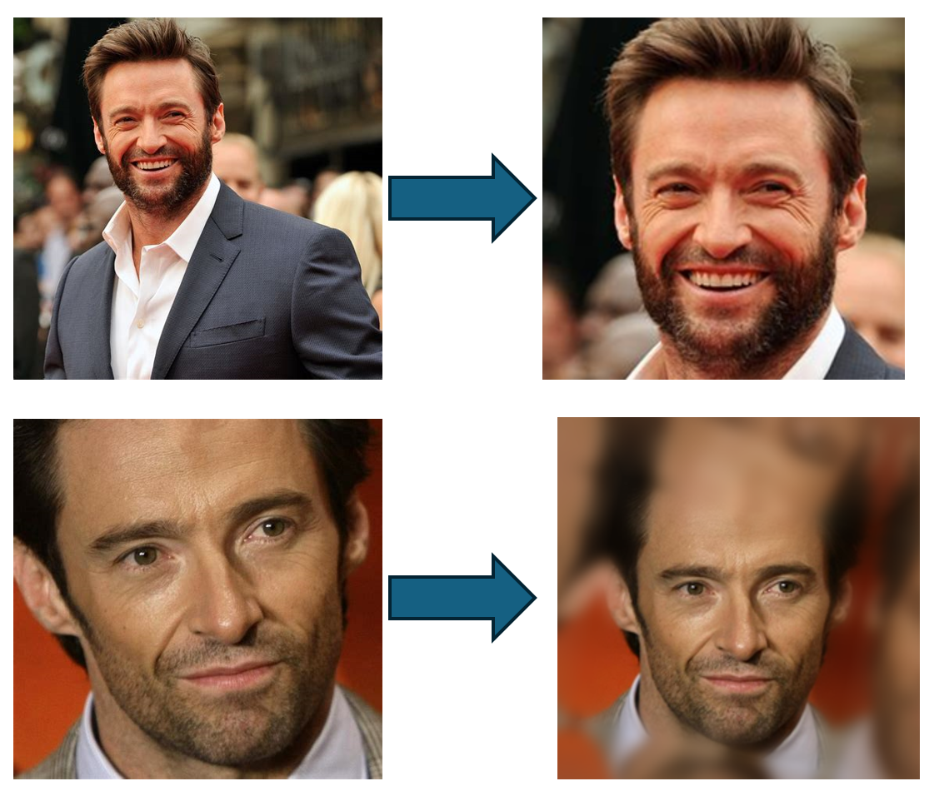
Preprocessing:
Face alignment:
  Detect 68 facial landmarks using Dlib
  Align face by rotating, centering, and scaling
  Apply reflection padding when faces are near image boundaries
Face alignment

Slide 5
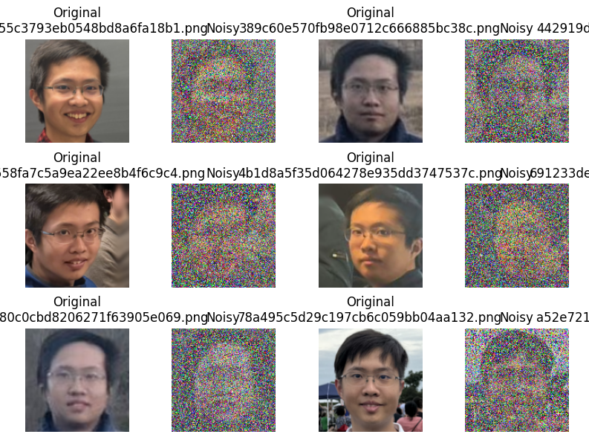
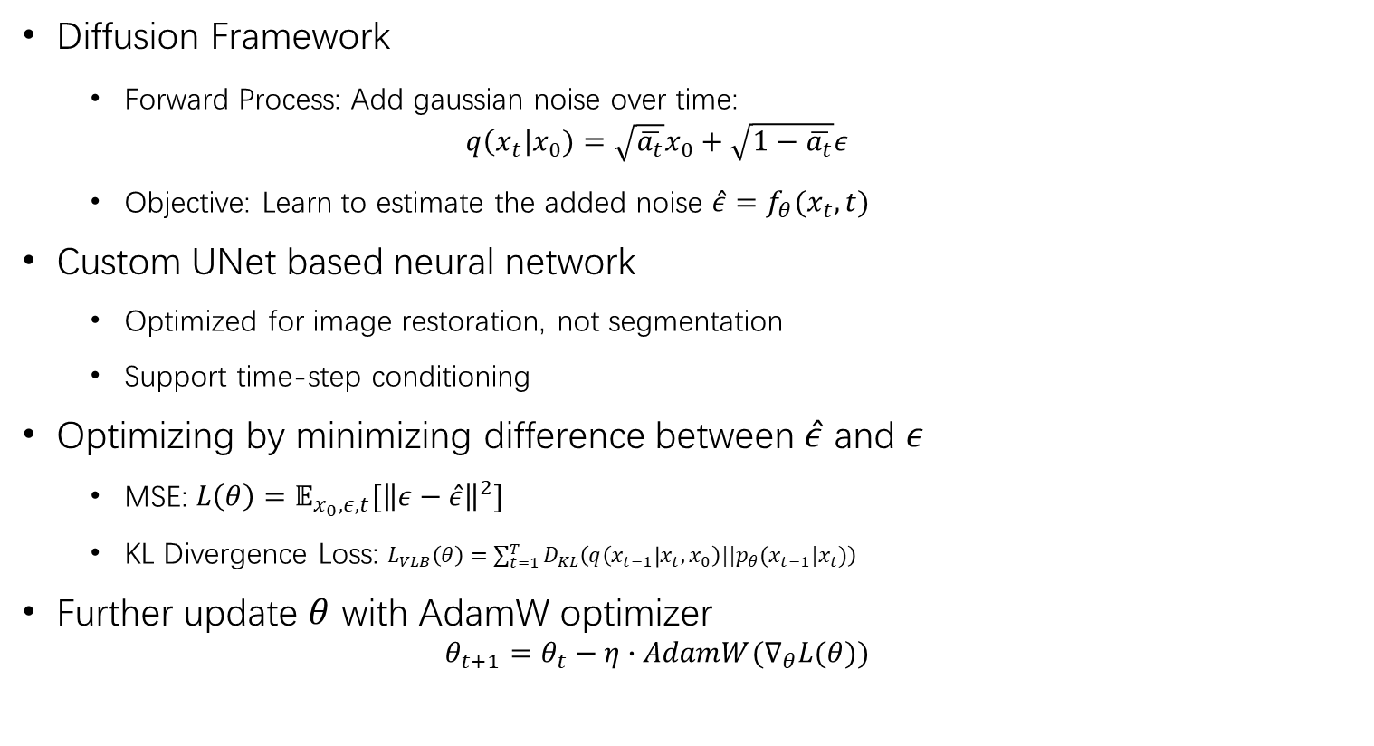
Training the Base Diffusion Model
Diffusion Framework
  Forward Process: Add gaussian noise over time:
  $q\left(x_{t}\right|x_{0})=\sqrt{\overline{a_{t}}}x_{0}+\sqrt{1−\overline{a_{t}}}ε$
  Objective: Learn to estimate the added noise $\hat{ε}=f_{θ}(x_{t},t)$
Custom UNet based neural network
  Optimized for image restoration, not segmentation
  Support time-step conditioning
Optimizing by minimizing difference between $\hat{ε}$ and $ε$
  MSE: $L\left(θ\right)=𝔼_{x_{0},ε,t}[{\left\|ε−\hat{ε}\right\|}^{2}]$
  KL Divergence Loss: $L_{VLB}\left(θ\right)=\sum_{t=1}^{T}{D_{KL}\left(q\left(x_{t−1} | x_{t},x_{0}\right)||p_{θ}(x_{t−1}|x_{t})\right)}$
Further update $θ$ with AdamW optimizer
  $$θ_{t+1}=θ_{t}−η∙AdamW(∇_{θ}L(θ))$$
Forward Diffusion Process

Slide 6
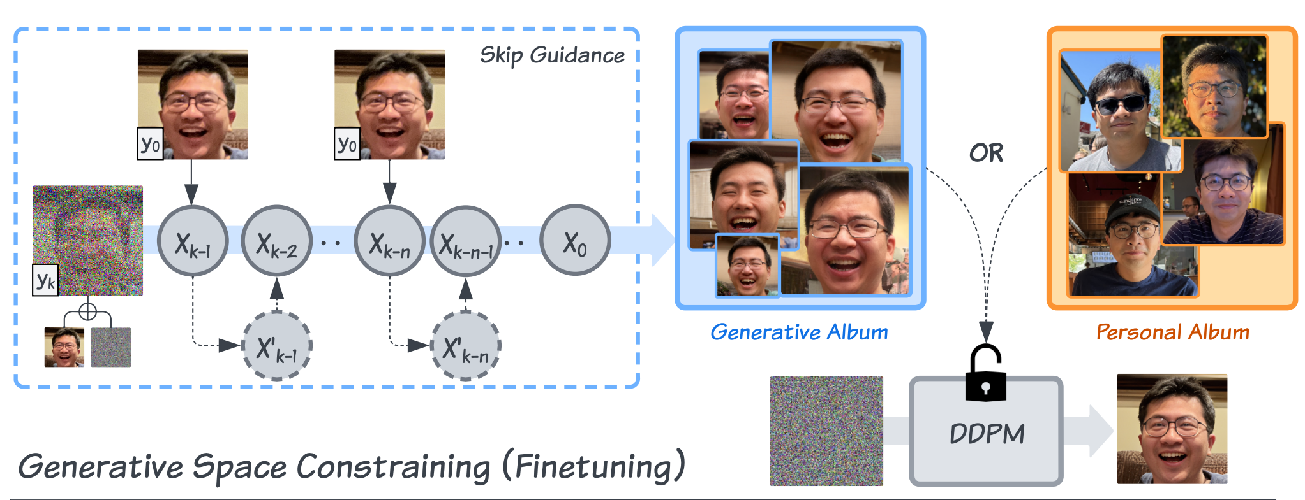
Finetuning Process
Improve restoration for a specific subject
  Finetune all model weights using a personal or generated album
  Constrain generative space to preserve identity during restoration
  Use pretrained checkpoint with small learning rate & EMA updates
  If no personal album, generate one using base model from noisy input
    Different result from sampling variation and guidance skip
  Save as separate personalized checkpoint
    Strong identity match
    Higher memory, time, and overfitting risk

Slide 7
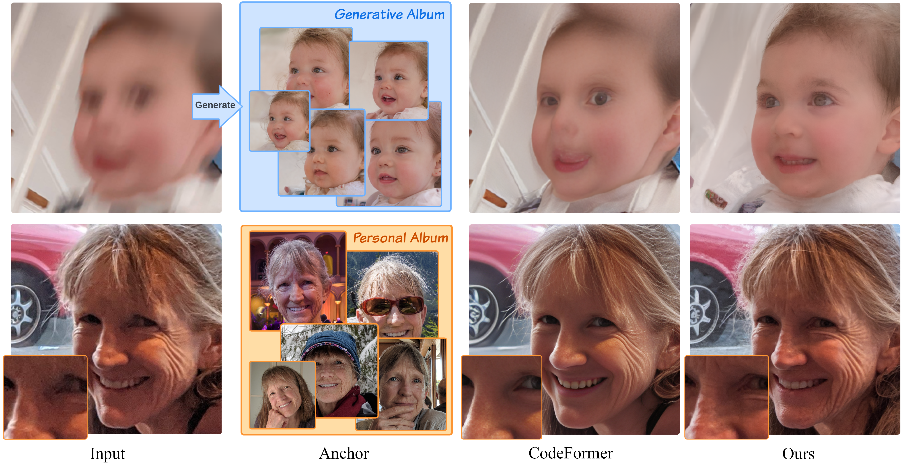
Restoration Process
Add noise to the input degraded image to match a target diffusion timestep
Denoise iteratively using the trained model
Use sampling with EMA weights for improved stability and output quality
Eventually output a high-quality, identity-preserving restored image

Slide 8





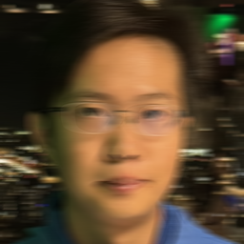


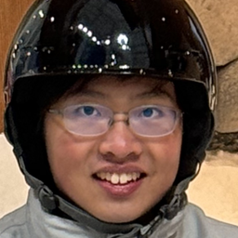



Effect of Album Size on Gen2Res Finetune
Evaluate impact of personal album size on full parameter finetune
Finetune with album size of 5, 15, and 40 images
Test images degraded by Gaussian/Motion blur (kernel=15)
Measured PSNR, SSIM, and LPIPS for restoration quality
Gaussian Blur Kernal Size=15
Original
Motion Blur Kernal Size=15

Slide 9

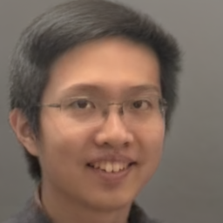

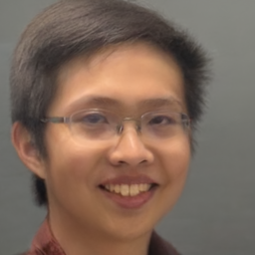






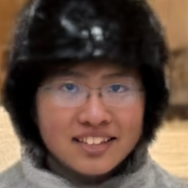
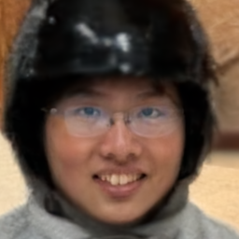
Gaussian Blurred Restoration Comparison
Original Image
Gaussian Blurred
Base Resto
Fine Resto
(AS=5)
Fine Resto (AS=15)
Fine Resto (AS=40)

Slide 10

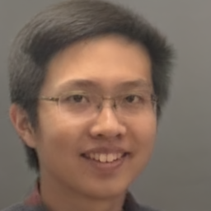
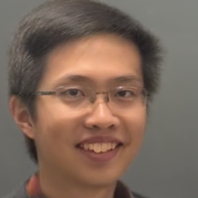





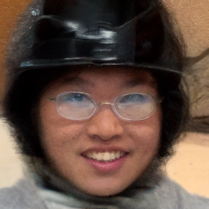
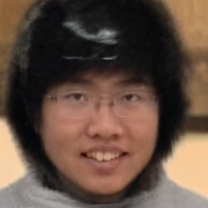
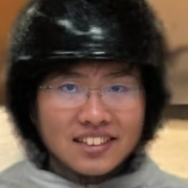
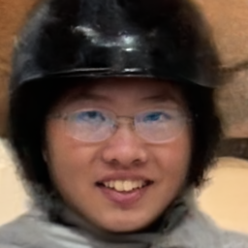
Motion Blurred Restoration Comparison
Original Image
Motion Blurred
Base Resto
Fine Resto
(AS=5)
Fine Resto (AS=15)
Fine Resto (AS=40)

Slide 11
Comparison and Results
SSIM increases with album size, indicating better structural preservation
PSNR
SSIM
LPIPS
 | img1 | img2 | img3 | img4
Gaussian Blurred img | 34.23 | 30.47 | 32.06 | 31.25
Restored img AS=0 | 31.82 | 29.47 | 30.45 | 29.98
Restored img AS=5 | 31.08 | 28.89 | 29.63 | 29.13
Restored img AS=15 | 31.95 | 29.38 | 30.29 | 29.94
Restored img AS=40 | 32.51 | 29.6 | 30.52 | 30.12
 | img1 | img2 | img3 | img4
Gaussian Blurred img | 0.8677 | 0.644 | 0.7512 | 0.7053
Restored img AS=0 | 0.7627 | 0.5286 | 0.638 | 0.5611
Restored img AS=5 | 0.7834 | 0.5091 | 0.6116 | 0.5264
Restored img AS=15 | 0.8041 | 0.5591 | 0.6568 | 0.5909
Restored img AS=40 | 0.8122 | 0.5739 | 0.6659 | 0.5991
 | img1 | img2 | img3 | img4
Gaussian Blurred img | 0.3019 | 0.4981 | 0.4126 | 0.4236
Restored img AS=0 | 0.1567 | 0.3167 | 0.2847 | 0.3264
Restored img AS=5 | 0.1543 | 0.4248 | 0.3343 | 0.3551
Restored img AS=15 | 0.1331 | 0.328 | 0.3393 | 0.3499
Restored img AS=40 | 0.103 | 0.3018 | 0.3746 | 0.3406
 | img1 | img2 | img3 | img4
Motion Blurred img | 33.6 | 30.17 | 31.79 | 30.91
Restored img AS=0 | 31.16 | 29.31 | 30.21 | 29.82
Restored img AS=5 | 31.04 | 28.83 | 29.55 | 28.91
Restored img AS=15 | 31.98 | 29.25 | 30.3 | 29.76
Restored img AS=40 | 32.34 | 29.38 | 30.42 | 29.99
 | img1 | img2 | img3 | img4
Motion Blurred img | 0.8454 | 0.6081 | 0.7313 | 0.6572
Restored img AS=0 | 0.6991 | 0.4965 | 0.6077 | 0.5669
Restored img AS=5 | 0.791 | 0.4918 | 0.6193 | 0.5157
Restored img AS=15 | 0.8082 | 0.5372 | 0.6607 | 0.5692
Restored img AS=40 | 0.8069 | 0.5435 | 0.6587 | 0.5935
 | img1 | img2 | img3 | img4
Motion Blurred img | 0.2601 | 0.4093 | 0.3209 | 0.3624
Restored img AS=0 | 0.2371 | 0.3067 | 0.243 | 0.3211
Restored img AS=5 | 0.1566 | 0.445 | 0.3098 | 0.3718
Restored img AS=15 | 0.1168 | 0.3094 | 0.2965 | 0.3443
Restored img AS=40 | 0.1112 | 0.2873 | 0.3141 | 0.306
AS=5 often underperforms, sometimes worse than the base model, especially under motion blur
AS=40 often gives the best results across PSNR, SSIM, and LPIPS, but sometimes underperform than AS=15
AS=15 offers a strong balance between performance and dataset size
PSNR & SSIM general increase with AS, indicating improved pixel accuracy and structure preservation
However, restored images often have lower PSNR/SSIM than blurred inputs, showing limits in perceptual alignment
LPIPS decreases with AS, better matching human perception; most reliable for visual quality
Notes:
PSNR stands for Peak Signal-to-Noise Ratio. It's a measurement of how much distortion or noise affects the quality of an image or video
As reconstruct, distortion occurs, but the effect is getting better
SSIM Structural Similarity Index similarity between the images
More similar as SSIM value increase
A "LPIPS" value, which stands for "Learned Perceptual Image Patch Similarity", represents a measure of how similar two images are perceived by humans, with a lower LPIPS score indicating that the images are more visually similar according to human perception, while a higher score means they are more different.
AS=5 is sometimes worse than AS=0

Slide 12




Limitation and Improvement for Gen2Res
Limitations of Gen2Res
  High memory and compute cost from full parameter tuning
  Slow and compute intensive training
  Risk of overfitting with small personal datasets
  Separate checkpoints, lack flexibility for reuse or combination
Solution: Use Low-Rank Adaptation (LoRA)

Slide 13
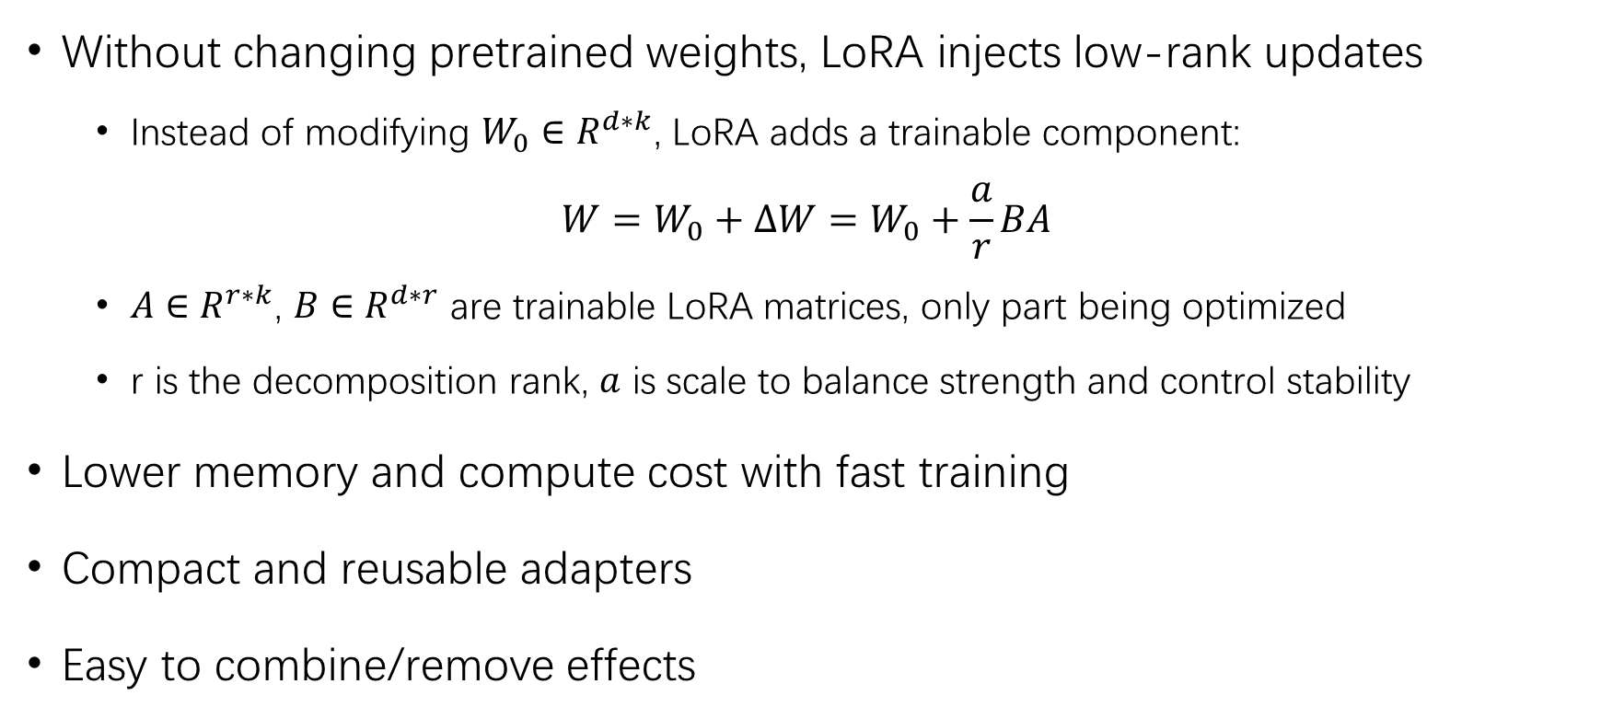
LoRA Finetune
Without changing pretrained weights, LoRA injects low-rank updates
  Instead of modifying $W_{0}∈R^{d∗k}$, LoRA adds a trainable component:
$$W=W_{0}+∆W=W_{0}+\frac{a}{r}BA$$
  $A∈R^{r∗k}$, $B∈R^{d∗r}$ are trainable LoRA matrices, only part being optimized
  r is the decomposition rank, $a$ is scale to balance strength and control stability
Lower memory and compute cost with fast training
Compact and reusable adapters
Easy to combine/remove effects

Slide 14
LoRA Injection Overview
LoRA is selectively injected into key UNet components for efficient personalization
Attention Layers (QKV+Output)
  Captures identity via long range interactions
  Most effective for restoring facial structure
Residual Blocks (in/out layers)
  Targets local features and texture details
Timestep Embeddings (MLP layers)
  Modulates behavior based on denoising step
  Helps align restoration with noise level

Slide 15
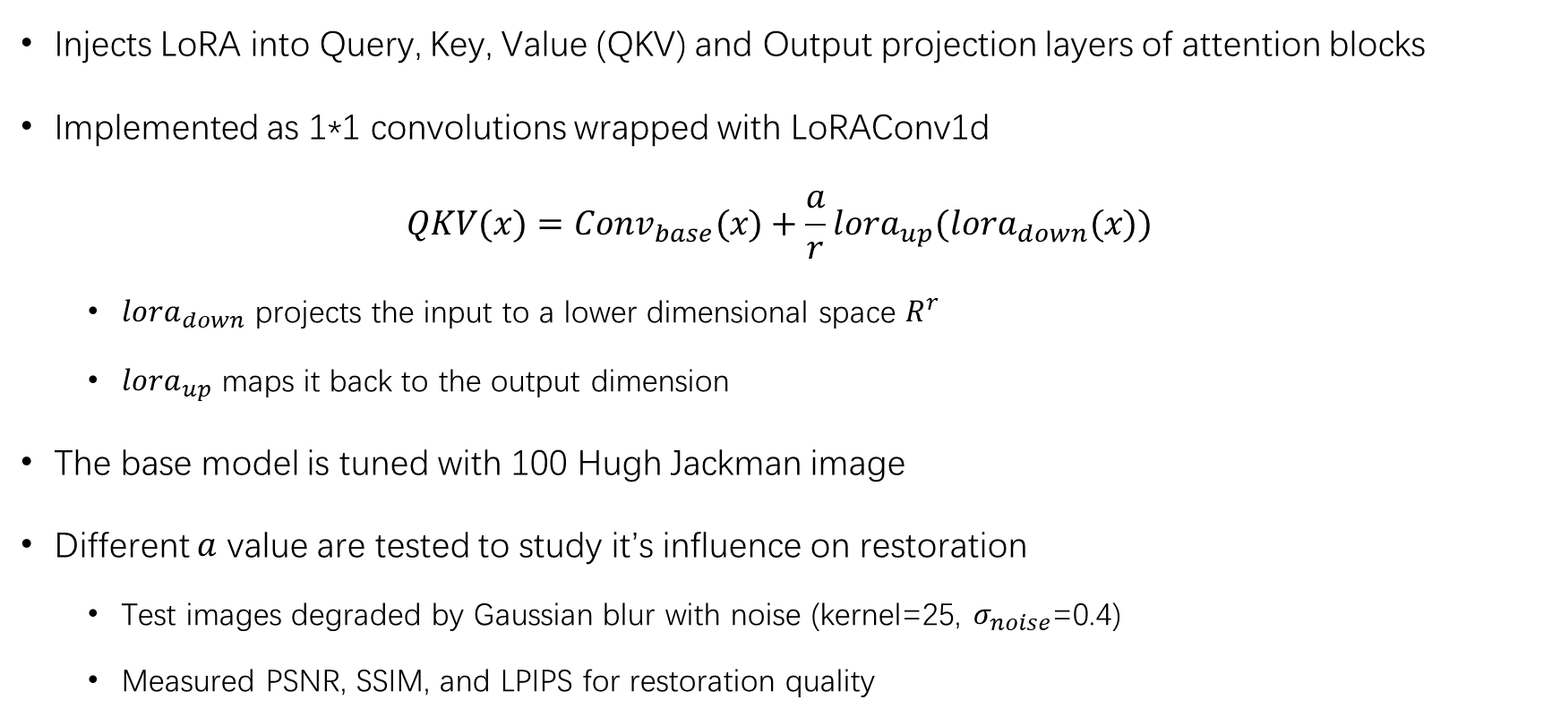
Attention Layer
Injects LoRA into Query, Key, Value (QKV) and Output projection layers of attention blocks
Implemented as 1*1 convolutions wrapped with LoRAConv1d
$$QKV(x)=Conv_{base}(x)+\frac{a}{r}lora_{up}(lora_{down}(x))$$
  $lora_{down}$ projects the input to a lower dimensional space $R^{r}$
  $lora_{up}$ maps it back to the output dimension
The base model is tuned with 100 Hugh Jackman image
Different $a$ value are tested to study it’s influence on restoration
  Test images degraded by Gaussian blur with noise (kernel=25, $σ_{noise}$=0.4)
  Measured PSNR, SSIM, and LPIPS for restoration quality

Slide 16
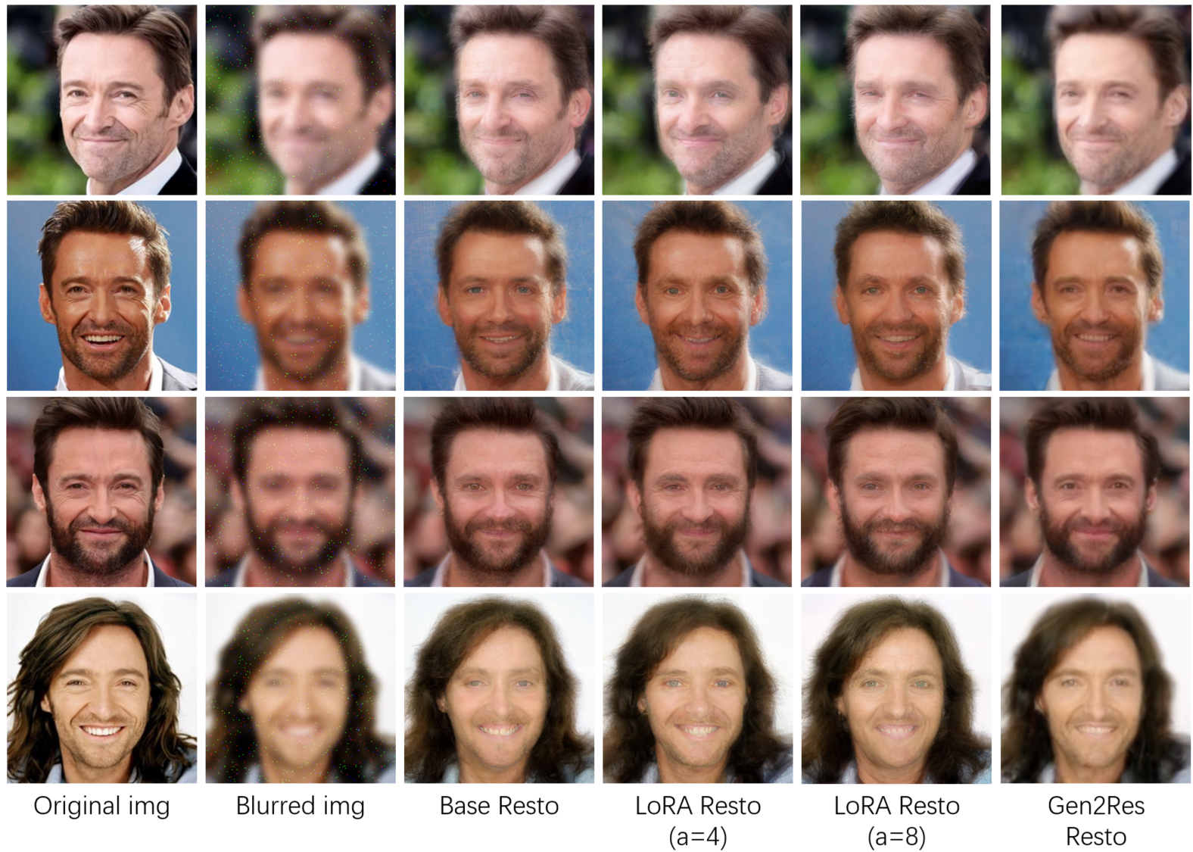
Restoration Comparison for different LoRA scale:
Notes:
From the image comparison above, we observe that restoration with LoRA applied to attention layers recovers more fine details than the base model alone. Features such as wrinkles near the eyes and mouth, as well as the shapes of the eyes, beard, and ears, are more accurately reconstructed. The LoRA enhanced outputs also convey more vivid facial expressions. These improvements generally strengthen as the LoRA scale increases. However, higher scales also lead to smoother textures, which may slightly reduce sharpness. Overall, while LoRA based restoration shows clear improvements over the base model, it still falls slightly short of the full finetuning performance achieved by the original Gen2Res method.

Slide 17
Comparison for different LoRA scale:
PSNR
No major difference in PSNR between LoRA and Base
SSIM generally increase with LoRA scale, better score than base
Gen2Res have highest PSNR/SSIM
LPIPS decrease consistently as LoRA scale increase, outperform Gen2Res
Visually, LoRA have more fine details than the base model
  More vivid facial expressions
  Higher scales also lead to smoother textures
LoRA attention tuning generally improves restoration over the base model
Improvements become more noticeable as scale factor increases
 | img1 | img2 | img3 | img4
Blurred and noisy img | 30.95 | 31.01 | 30.77 | 29.94
Base Resto | 29.73 | 29.92 | 29.78 | 29.55
LoRA Resto (a=4) | 29.74 | 30.13 | 29.68 | 29.49
LoRA Resto (a=8) | 29.66 | 30.13 | 29.62 | 29.54
Gen2Res Resto | 29.78 | 30.35 | 29.85 | 29.6
SSIM
 | img1 | img2 | img3 | img4
Blurred and noisy img | 0.6103 | 0.5656 | 0.6097 | 0.5558
Base Resto | 0.6506 | 0.6015 | 0.6776 | 0.5409
LoRA Resto (a=4) | 0.6443 | 0.6175 | 0.6867 | 0.5450
LoRA Resto (a=8) | 0.6586 | 0.6295 | 0.6847 | 0.5432
Gen2Res Resto | 0.6998 | 0.6890 | 0.7390 | 0.5886
LPIPS
 | img1 | img2 | img3 | img4
Blurred and noisy img | 0.6168 | 0.5669 | 0.6364 | 0.6183
Base Resto | 0.2644 | 0.2889 | 0.2414 | 0.3654
LoRA Resto (a=4) | 0.2535 | 0.2574 | 0.2319 | 0.3384
LoRA Resto (a=8) | 0.2471 | 0.2409 | 0.2281 | 0.3411
Gen2Res Resto | 0.2832 | 0.2663 | 0.2412 | 0.3587

Slide 18

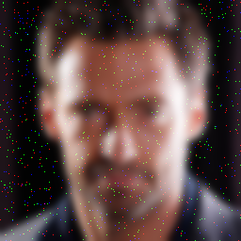




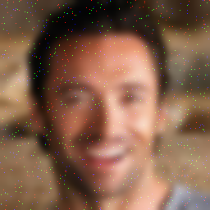




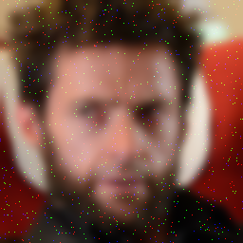




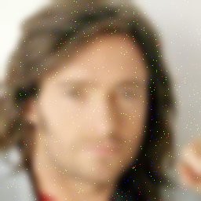



Resto on Training set
Original img
Blurred img
Base Resto
LoRA (a=4)
LoRA (a=8)

Slide 19
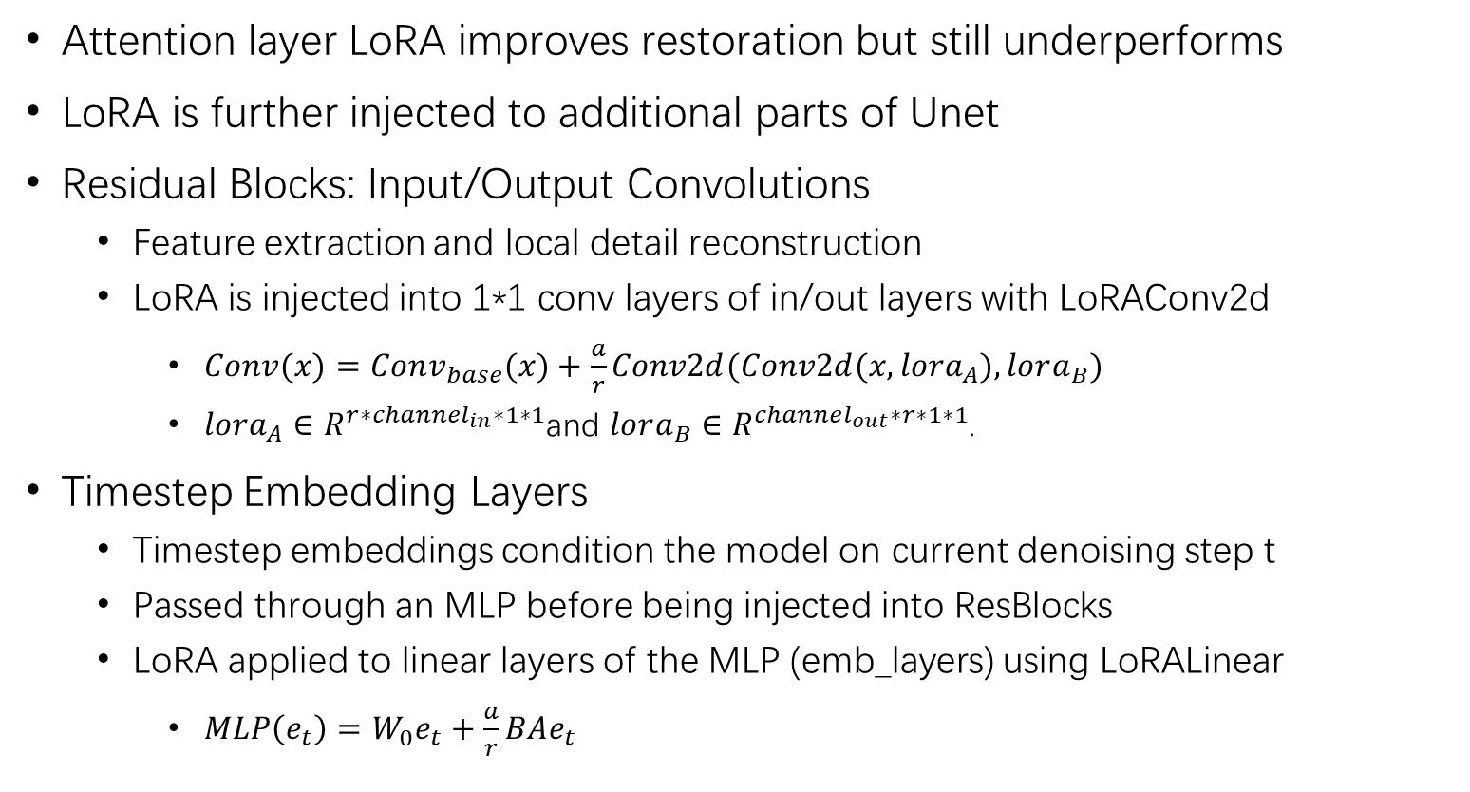
LoRA injection to more layer
Attention layer LoRA improves restoration but still underperforms
LoRA is further injected to additional parts of Unet
Residual Blocks: Input/Output Convolutions
  Feature extraction and local detail reconstruction
  LoRA is injected into 1*1 conv layers of in/out layers with LoRAConv2d
    $Conv(x)=Conv_{base}(x)+\frac{a}{r}Conv2d(Conv2d(x,lora_{A}),lora_{B})$
    $lora_{A}∈R^{r∗channel_{in}∗1∗1}$and $lora_{B}∈R^{channel_{out}∗r∗1∗1}$.
Timestep Embedding Layers
  Timestep embeddings condition the model on current denoising step t
  Passed through an MLP before being injected into ResBlocks
  LoRA applied to linear layers of the MLP (emb_layers) using LoRALinear
    $MLP\left(e_{t}\right)=W_{0}e_{t}+\frac{a}{r}BAe_{t}$
Notes:
Projects the input x to a lower-dimensional space
Projects the low-rank output back to the original dimension

Slide 20









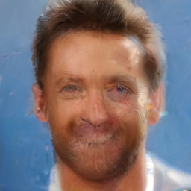





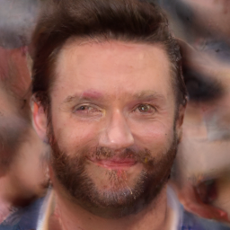





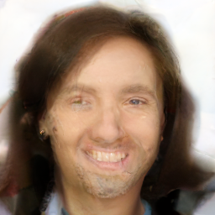
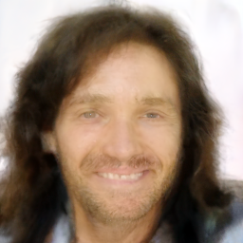

Comparison for different LoRA injection
Original img
Base Resto
Att LoRA
Att+Res
Att+Emb
Gen2Res
Notes:
Resblock
Poor visual effect
Artifacts and slight overlap in facial features,
Emb: outputs that appeared smoother but lacked sharpness and clarity,

Slide 21
Comparison for different LoRA injection
PSNR
SSIM
LPIPS
 | img1 | img2 | img3 | img4
Blurred and noisy img | 30.95 | 31.01 | 30.77 | 29.94
Base Resto | 29.73 | 29.92 | 29.78 | 29.55
LoRA Att | 29.74 | 30.13 | 29.68 | 29.49
LoRA Att+Res | 29.46 | 30.23 | 29.59 | 29.52
LoRA Att+Emb | 29.71 | 30.27 | 29.7 | 29.51
Gen2Res Resto | 29.78 | 30.35 | 29.85 | 29.6
 | img1 | img2 | img3 | img4
Blurred and noisy img | 0.6103 | 0.5656 | 0.6097 | 0.5558
Base Resto | 0.6506 | 0.6015 | 0.6776 | 0.5409
LoRA Att | 0.6443 | 0.6175 | 0.6867 | 0.5450
LoRA Att+Res | 0.6224 | 0.6324 | 0.6569 | 0.5592
LoRA Att+Emb | 0.6522 | 0.6499 | 0.6837 | 0.5594
Gen2Res Resto | 0.6998 | 0.6890 | 0.7390 | 0.5886
 | img1 | img2 | img3 | img4
Blurred and noisy img | 0.6168 | 0.5669 | 0.6364 | 0.6183
Base Resto | 0.2644 | 0.2889 | 0.2414 | 0.3654
LoRA Att | 0.2535 | 0.2574 | 0.2319 | 0.3384
LoRA Att+Res | 0.2852 | 0.2460 | 0.2324 | 0.3036
LoRA Att+Emb | 0.2604 | 0.2750 | 0.2584 | 0.3067
Gen2Res Resto | 0.2832 | 0.2663 | 0.2412 | 0.3587
Att+Res gives similar PSNR to Att, but worse visual effect even with better score
Att+Emb shows similar but slight gain in PSNR over Att in some cases
Att+Res yields inconsistent SSIM, with no clear visual correlation
Att+Emb generally improves SSIM, outperforming Att
Att+Res increases LPIPS, indicating visual artifacts
Att+Emb overperform base, but underperform Att in LPIPS
Overall, Attention only best balance of structure and perceptual quality
Adding more layers (Res/Emb) doesn’t guarantee better results
Att+Res may degrade visuals; Att+Emb gives small SSIM boost, no perceptual gain

Slide 22
LoRA Efficiency Comparison
LoRA finetune significantly improves efficiency by reducing computational load, training time, and storage requirements:
 | Training time | GPU memory usage (MiB) | Model size(byte)
Gen2Res finetune | 44:11 | 10452 | 527,068,365
LoRA Att | 23:58 | 5498 | 200,129
LoRA Att+Res | 36:28 | 7052 | 2,070,937
LoRA Att+Emb | 28:51 | 7332 | 984,965
LoRA Efficiency Comparison
Batch Size=2, 5000 steps

Slide 23
Conclusion
Successfully replicated Gen2Res and extended it with LoRA finetune
Attention only LoRA offers strong perceptual quality (LPIPS) with:
  99.97% model size reduction
  Half training time
  Half memory usage
Personalization improves with:
  Larger album sizes, but limited improvement beyond a threshold
  Higher but stable LoRA scaling
Extending LoRA to ResBlocks or Embeddings:
  Mixed gains in PSNR/SSIM
  Often worse LPIPS

Slide 24
Limitation and Further Improvement
Limitations:
  Key LoRA hyperparameters (r, a, relative weight) are not optimized
  Combination of different layer LoRA may not show full potential
  MSE loss may not align well with perceptual quality
Improvement:
  Hyperparameter parameter tuning and adaptive scaling
  Modifying loss function, combining with LPIPS
  Broader data and experiment for better generalization

